Slide 1
UAV Ground Detection
Distinguish Tree Species
Christian Ekeigwe, Daehyeon Jeong, Jaeyeong Shim, Jeonghwan Kang, Seoungheong Jeong
Project 17

Slide 2
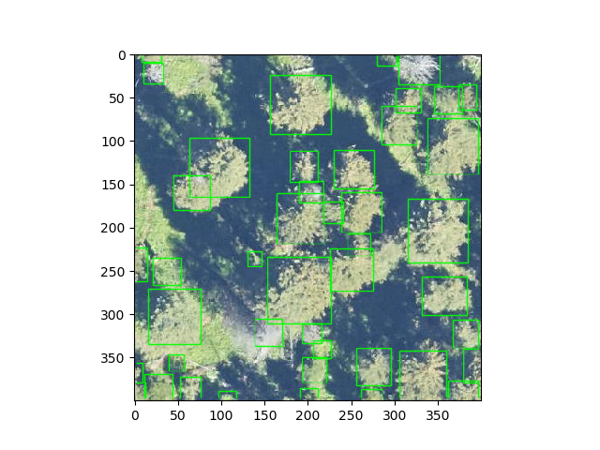
Detecting Tree model
Deep Forest
Training and predicting individual tree airborne RGB image
https://deepforest.readthedocs.io/en/latest/landing.html

Slide 3
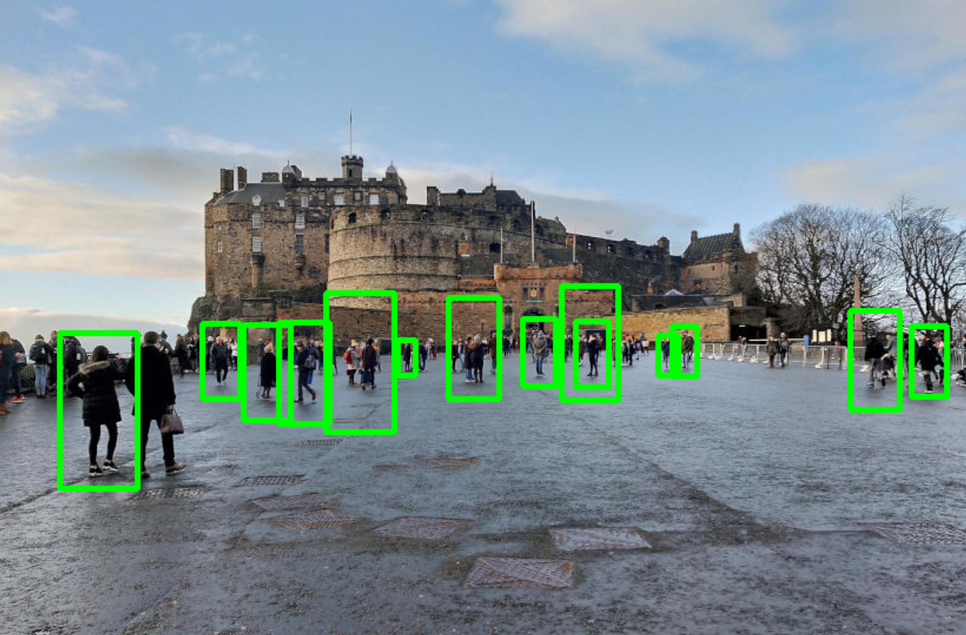
Detect Objects in Real Time
Using OpenCV and Python
When using UAV ground detecting we need to use real time object detection
OpenCV?
library of programming functions mainly aimed at real-time computer vision.

Slide 4
Detect Objects in Real Time
Using OpenCV and Python
When using UAV ground detecting we need to use real time object detection
OpenCV?
library of programming functions mainly aimed at real-time computer vision.

Slide 5
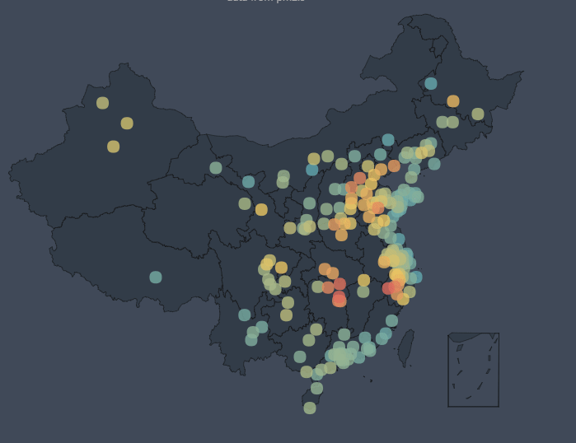
Tree data with GPS
We need to use tree data with GPS
Then we can make GEO charts.
Maybe we can use some libraries like pyecharts.
But, how to get this data?

Slide 6
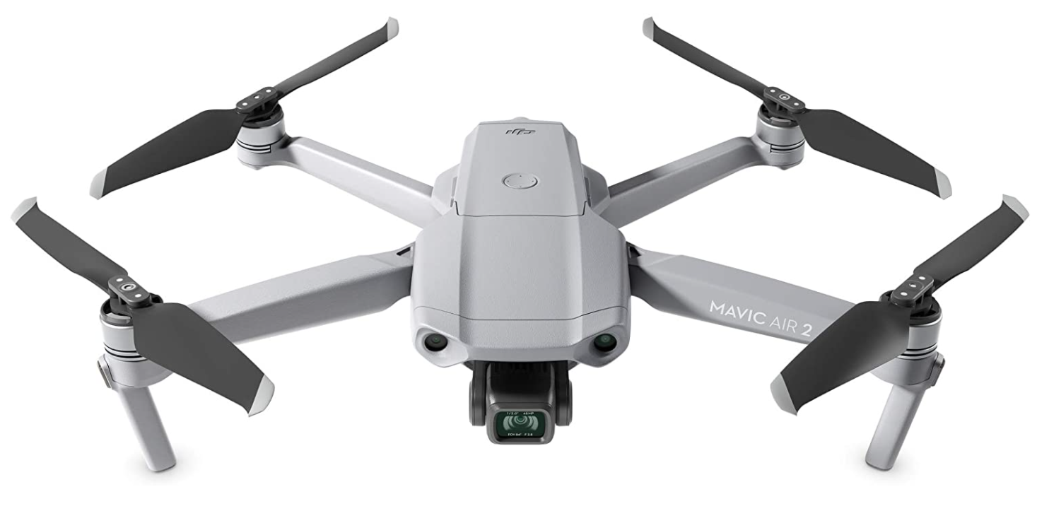
Collecting data using UAV
Collecting data using UAV
But we think it is hard to use UAV in Korea forest and gathering data.
So, we try to find some new method.
Finally, we find a solution

Slide 7
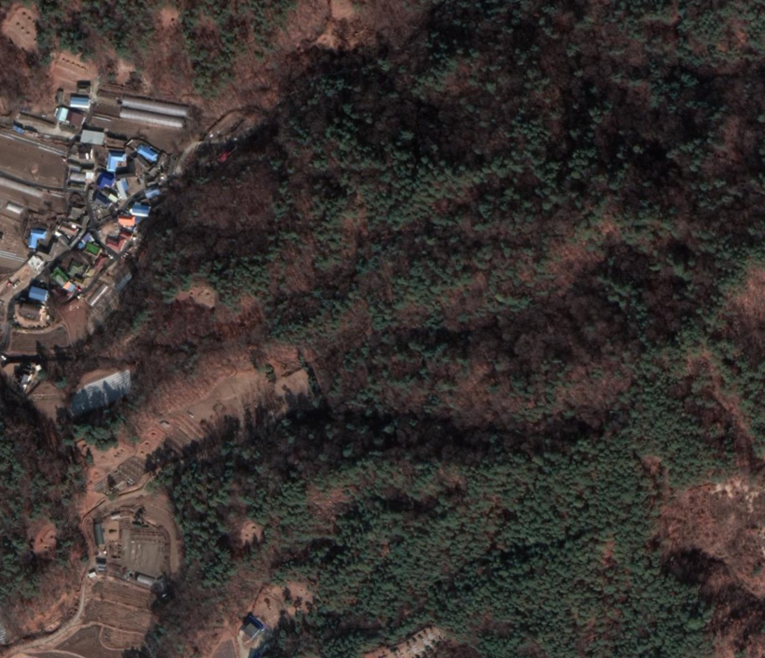
Google map trick
We’ll use google map api
We can get satellite picture of forest.
It contains RGB and GPS data.
Then now, we have modeling data.

Slide 8
Plan
Step 1
Get data from gMap
Make modeling system
Classify data
(Distinguish Tree Species)
Modeling data
Step 2
Real time receive data from UAV
Add/Del data from GEO chart
Step 3

Slide 9



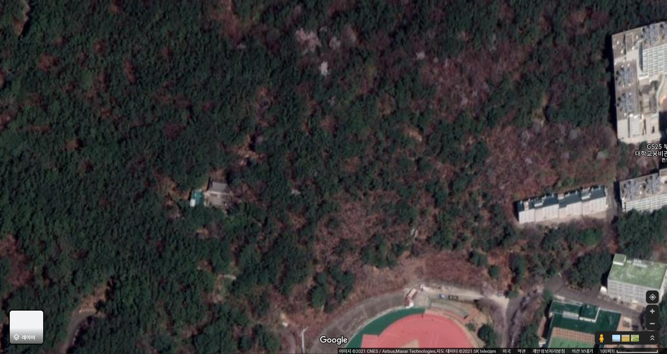
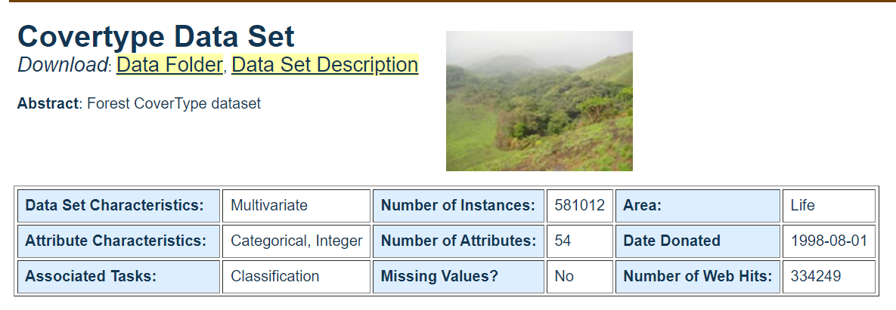
Step 1
How do we collect map data?
From Google Map API
External Dataset
Notes:
Most of all, the first thing you will do is to collect data. The easiest way is to collect satellite data using Google Map API which enables us to obtain most forest data in the world with few costs. It’s not difficult to edit data with any ‘Library’ like Python ‘Request.’ However, some data has lack of resolution, and they create similar data for visually repeated terrain. The area for military or national institutions are not provided. Of course, there's a detour, but it's not the right way.
The other method is to collect data by Kaggle, Machine Learning Repository of UCI or external dataset. It helps to receive processed data suitable to Machine Learning, but hard to select data that we want.

Slide 10
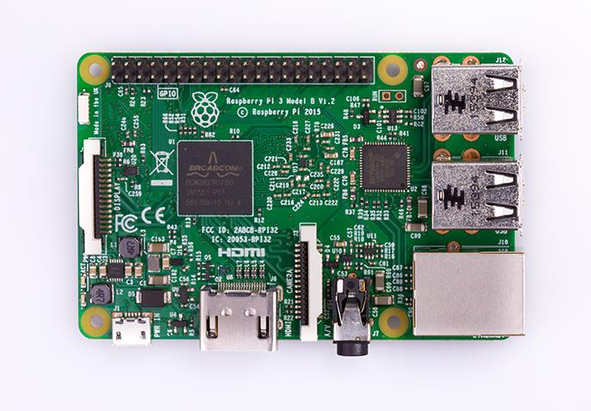
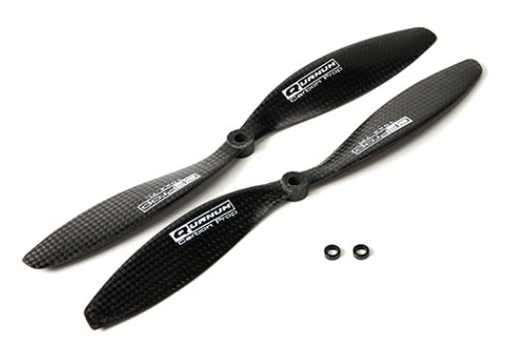

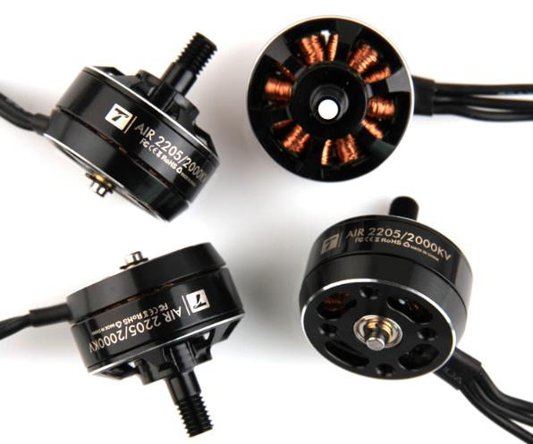
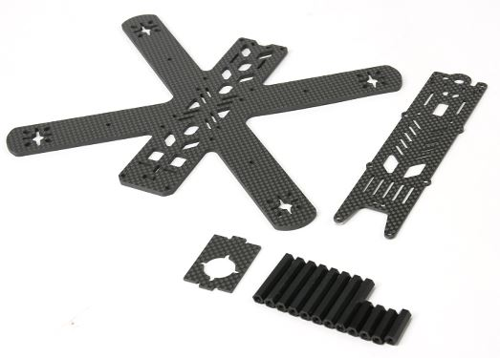
NEXT
What about UAV?
We have to build drones
Notes:
Even though UAV is the optimal choice for the data we want ourselves. but some issues are still open due to its technical problems. We can’t use commercial product for the project, and moreover, semi-assembled/kit-type drones cannot meet our requirements. So, we have to build a drone from the beginning, but the decision is delayed because of the cost (At least $500) and no experienced person. we will make a decision on this as soon as possible.

Slide 11
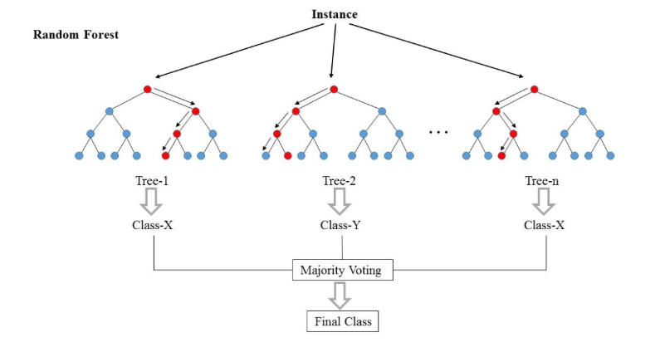
Step 2
Classify data
(Distinguish Tree Species)
Modeling data
Classification
Notes:
Basically, the main gold of this project is to classify trees, so we will drill down into the algorithm of classification, such as KNN, Decision Tree, Random Forest, Naïve Bayes, SVM and else. I guess it’s almost impossible to choose the perfectly matching algorithms that produce the best result for the first time. We will just have to keep repeating and tuning them.

Slide 12
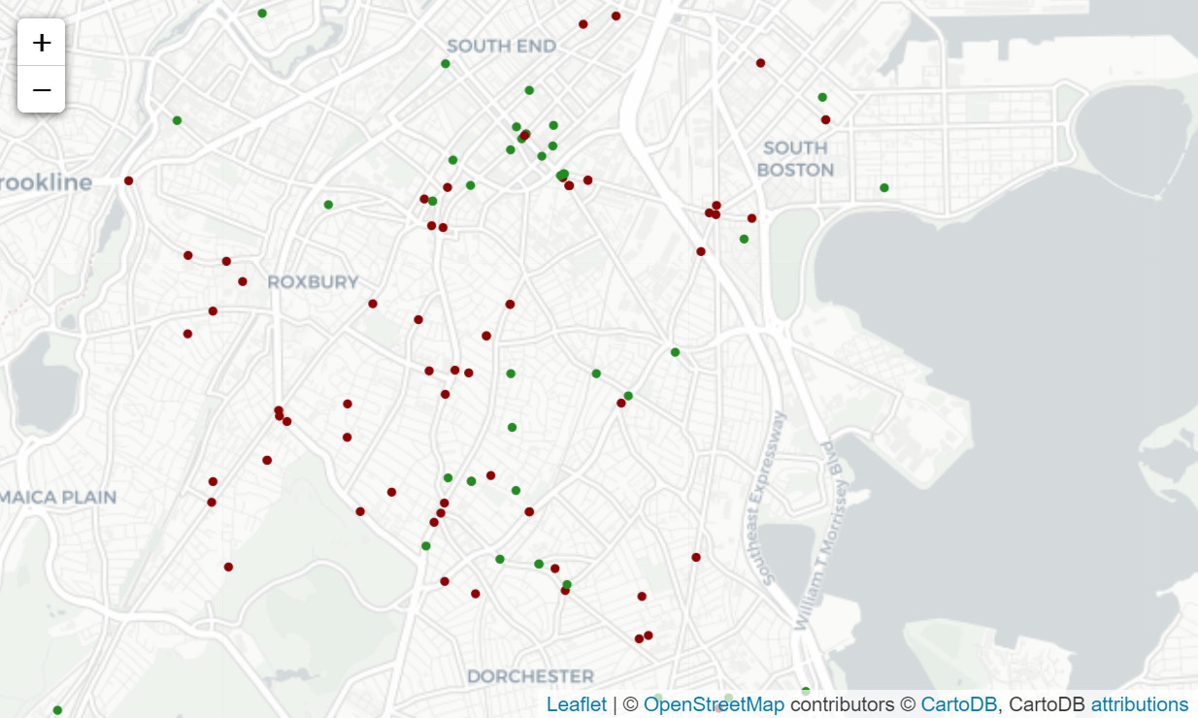
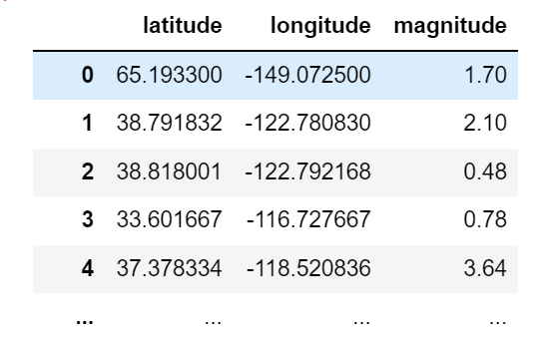
Step 3
Data Visualization
Marker on Map
Notes:
The last step is Data visualization which presents the final outcomes in a simpler way, which is very important. There will be many ways to visualize the data, but intuitively, we are considering marking the types of trees by color on the map. If we can sort out trees and obtain the data of the latitude and longitude for each tree, it’s available to mark on a map with Python ‘folium’ library.
The whole series of processes I mentioned will be done by Python and I expect to automate the sequence.
Thank you for listening.

Slide 13
Thank you
Questions?

